Slide 1


Browse Buddy

Slide 2
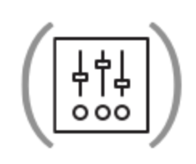
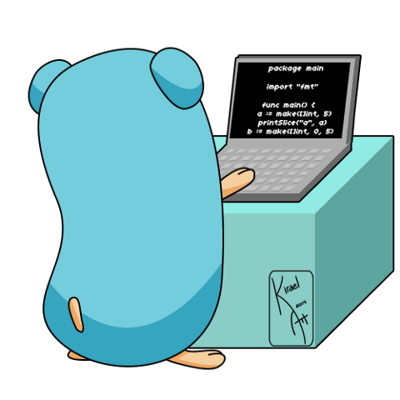
What is Browse Buddy?
Recommendation System based on URL Paths
Cloud
Python & Py2Neo
Go
Docker
yFiles

Slide 3
How does it work?
URL Parser
Tilda (~) Separated Value
Neo4j
Text from URL

Slide 4
Next Steps
More visualization outside of Neo4j

